Slide 1
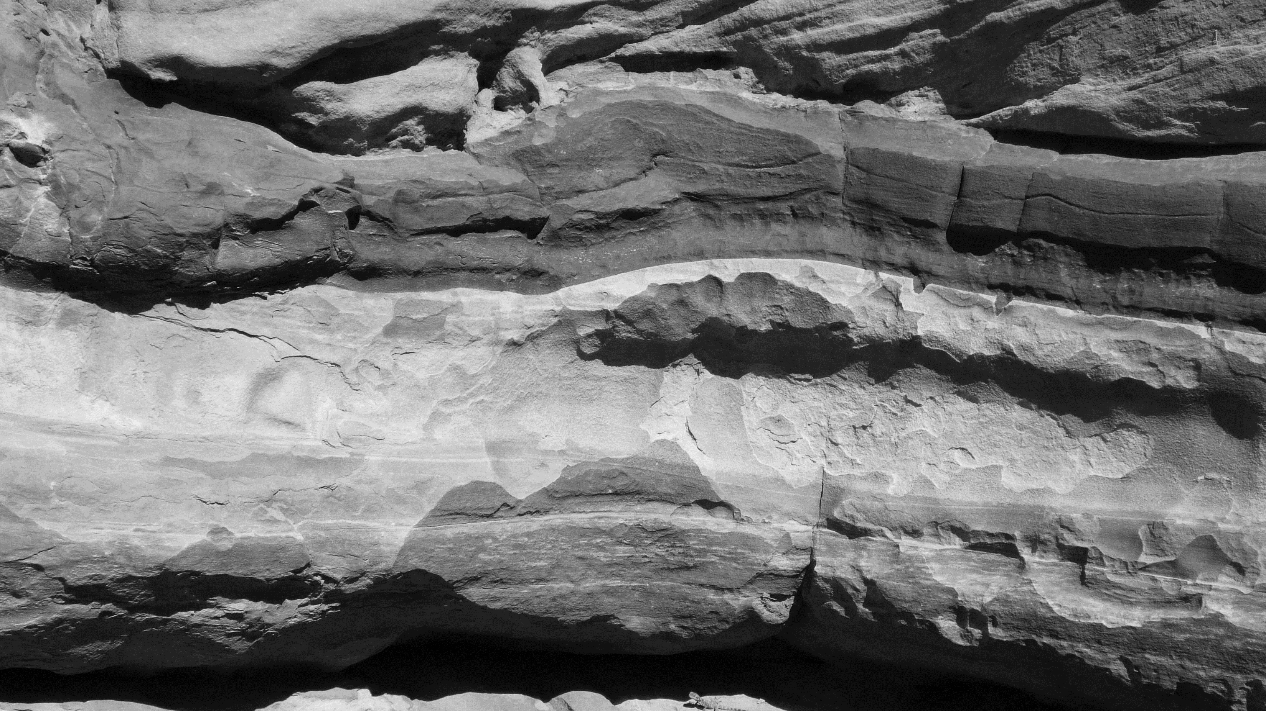

GeoPredictors
GEMS Group Project 2
Group Members – Anthony Tran, Muhammad Ismayliov, Yassine Charouif, Junyi Li, Bin Wu, Zhibo Miao, Wuldan Edyawan, Alexander Stringer, Boyu Liu
Notes:
Introduction – Presented by NAME HERE
Add Speakers Notes Here…

Slide 2


Project Approach
We broke into three teams, each tasked with one of three core features...
Facies Classifier Model – Team 1
Anthony Tran, Muhammad Ismayliov, Yassine Charouif
Permeability Predictor Model – Team 2 Junyi Li, Bin Wu, Zhibo Miao
Visualization – Team 3 Wuldan Edyawan, Alexander Stringer, Boyu Liu
0.1
Notes:
Project Plan Overview - Presented by NAME HERE
Add Speakers Notes Here…

Slide 3
Facies Classifier Model – Team 1
Data used - Images processed using CoreBreakout
Best model - Custom ResNet34
Accuracy - 53 % on balanced data
1.1
Notes:
Classifier Model Slide 1 (Overview) – Presented by NAME HERE
Add Speakers Notes Here…

Slide 4
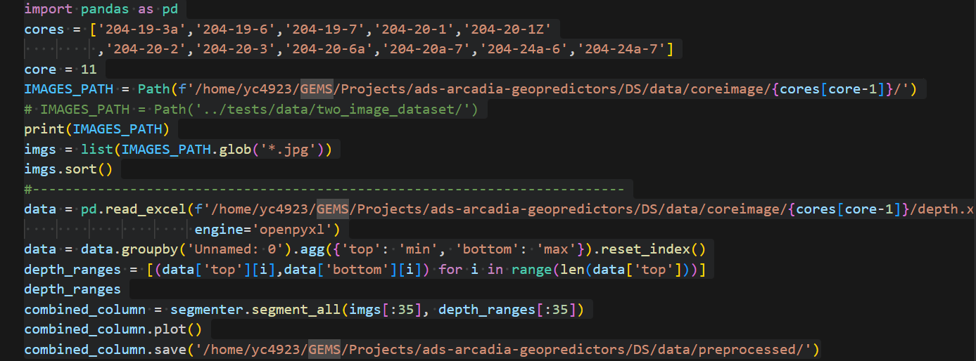
Facies Classifier Model - Findings
Data:
Core images were processed in segments
incomplete core column detection and inconsistencies in depth annotations
Modeling:
Tried CNNs and convolutional LSTM
Modified ResNet worked best
Unbalanced classes in favor of "nc“
70% on unbalanced data
Decided to train on balanced classes
1.2
Notes:
Classifier Model Slide 2 (Findings) – Presented by NAME HERE
Add Speakers Notes Here…

Slide 5
Facies Classifier Model - Improvements
Training on larger datasets
Use other cores
Use well log data
More balanced datasets
Higher accuracy labels for training
Ensemble Models
Combining predictions from multiple models can reduce overfitting and improve overall accuracy.
1.3
Notes:
Classifier Model Slide 3 (Insights) – Presented by NAME HERE
Add Speakers Notes Here…

Slide 6
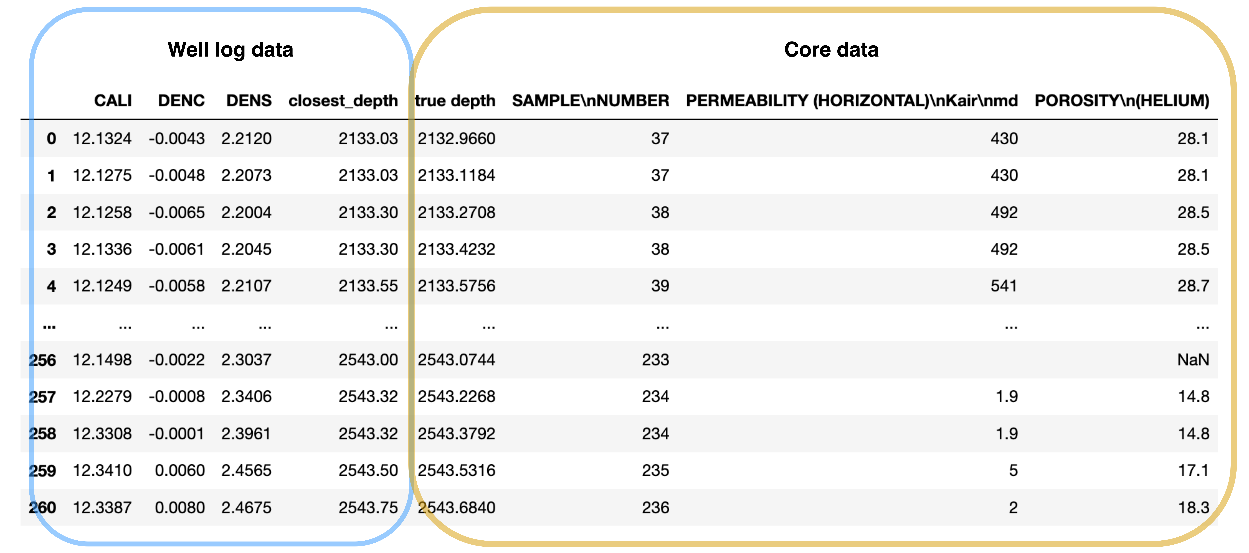
Permeability Predictor Model – Team 2
Well log and core data preprocessing
2.2
Notes:
Permeability Predictor Model Slide 2 (Findings) – Presented by NAME HERE
Add Speakers Notes Here…

Slide 7
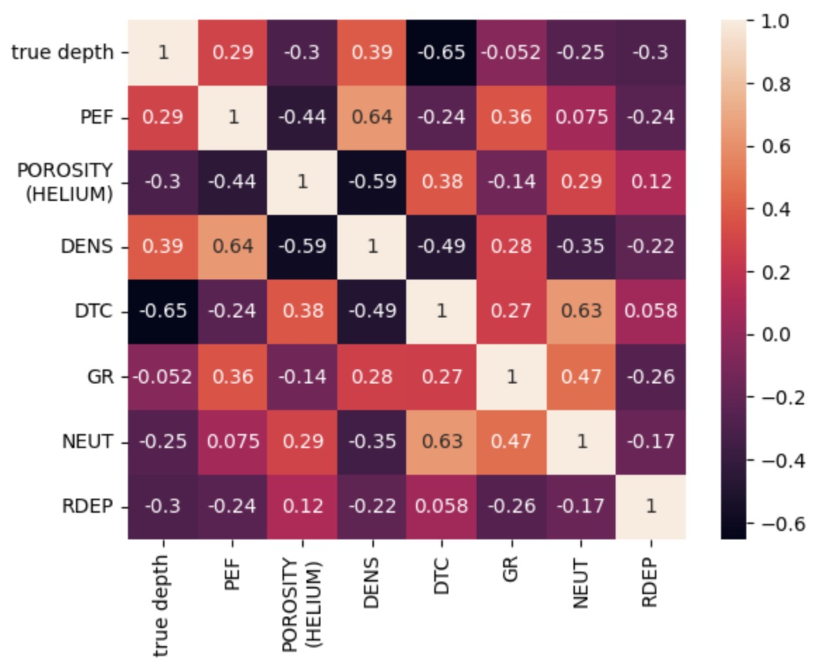
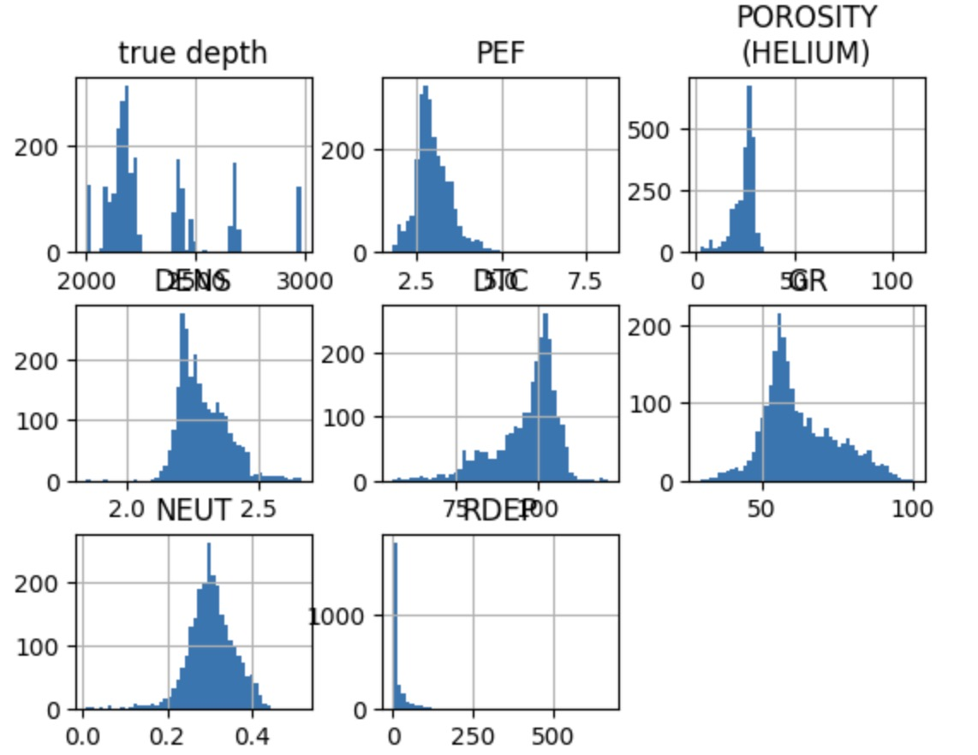
Permeability Predictor Model – Team 2
Exploration of data features
2.2
Notes:
Permeability Predictor Model Slide 2 (Findings) – Presented by NAME HERE
Add Speakers Notes Here…

Slide 8
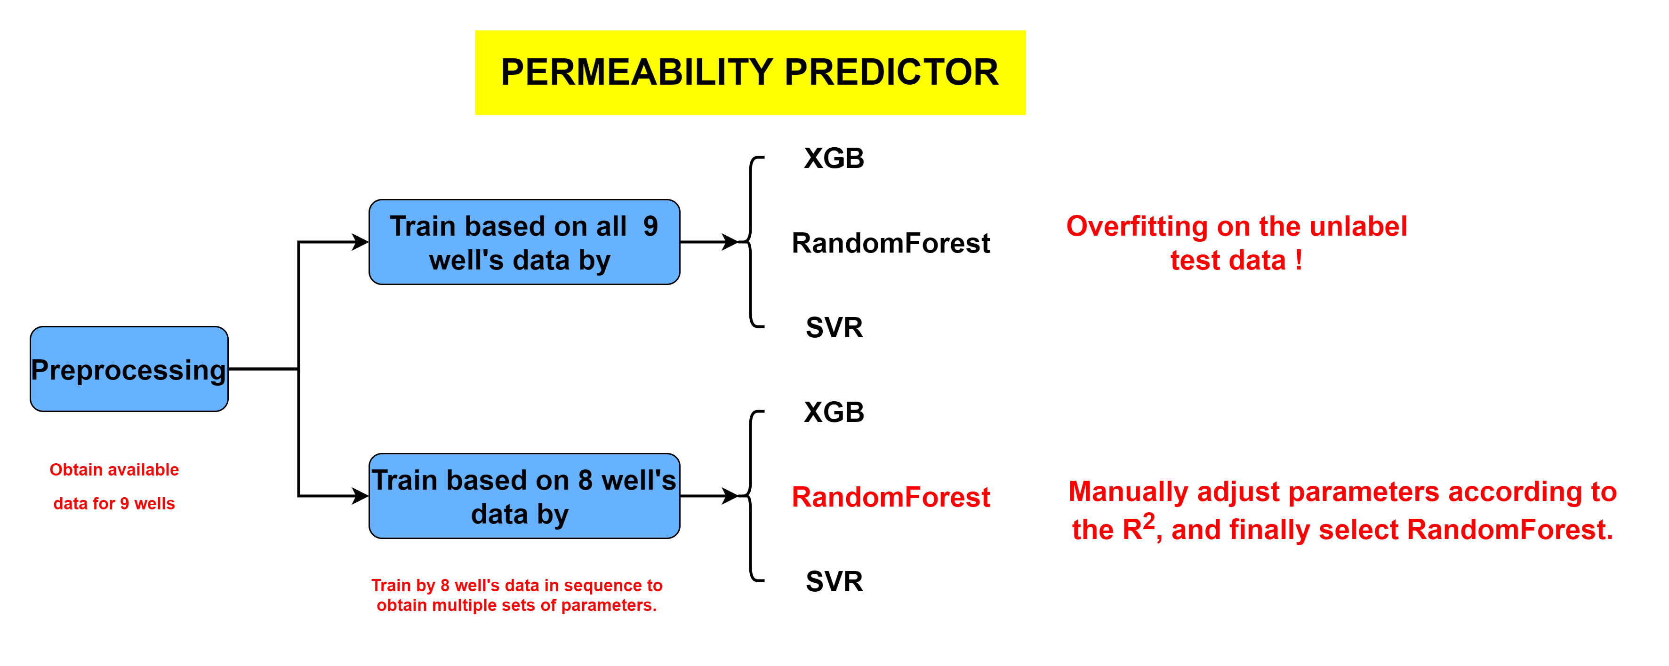
Permeability Predictor Model – Team 2
Model selection
2.1
Notes:
Permeability Predictor Model Slide 1 (Overview) – Presented by NAME HERE
Add Speakers Notes Here…

Slide 9
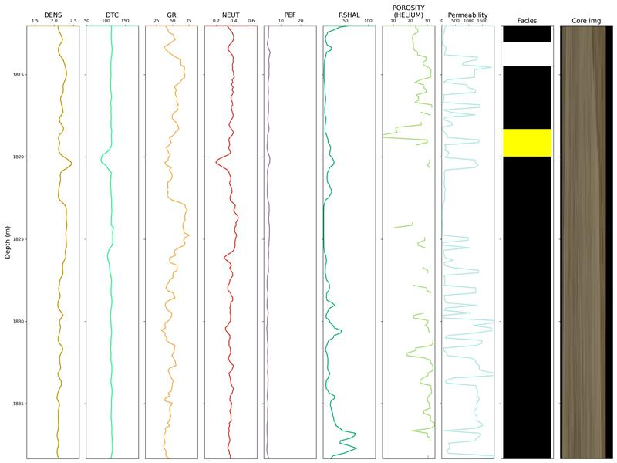
Visualization Model – Team 3
We chose to visualize the data in a way that is similar to a conventional wireline log, trying to prioritize interpretability and clarity for the user.
The team made separate plots and then combined the features of the best ones for the final plot.
The tool displays all important wireline log data, predicted permeability, predicted lithofacies and core image.
3.1
Notes:
Visualization Slide 1 (Overview) – Presented by Alex
Key for Lithofacies…
White = nc,
Black = ih, is, sh,
Yellow = s
Green = os
The current visualization is laid out in a way that would make it for someone studying it to make correlations between the different logs easily

Slide 10
Visualization Model - Findings
Predicted Lithofacies Plot
Predicted Permeability Plot
Other wireline log data plotted for context
In the future, we would aim to improve the visualization in these ways:
Interactivity – zoom tool, data popups, correlation draw tool
3D Modelling of area using other cores to reproduce subsurface
Possibly add a more conventional geological log plot
3.2
Notes:
Visualization Slide 2 (Findings) – Presented by Alex
Predicted lithofacies plot -
(Liu Boyu)
In visualization, we consider placing all images that need to be displayed on the same line for comparison. We take depth as the y-axis, and different feature values, predicted permeability results and classification results are arranged on the x-axis in sequence. When drawing different eigenvalues, the main consideration is the scaling of different data. Finally, we obtained a clearer result of the data relationship as shown in the figure. The predicted value of permeability is the same as the mapping of features. Just pay attention to the predicted value of individual special depths. We use hierarchical diagrams to display the classification results. This is more in line with the practical significance of stratigraphic distribution. Finally, combined with the complete picture we drew, important

Slide 11
Conclusions
Utilized pre-trained ResNet34 for lithofacies classification and Random Forest for permeability prediction, achieving notable accuracy through balanced training and strategic model selection.
The whole workflow can be seen in Notebooks/Workflow.ipynb
4.1
Notes:
Conclusions – Presented By… NAME HERE
Add Speakers Notes Here…
(Briefly mention references at end?)

Slide 12
References
https://www.frontiersin.org/articles/10.3389/feart.2021.659611/full

